Slide 1
EL213 ANALOG CIRCUITS
GROUP 17
LED MATRIX DISPLAY

Slide 2
INTRODUCTION
LED–based signage and matrix displays are bringing new dimensions of versatility and eye-pleasing effects to growing number of outdoor and indoor application. It is a flat panel display, which uses an array of light emitting diodes. LED displays are capable of providing general illumination in addition to visual display, as when used for stage lighting or other decorative purposes. There are numerous other applications some of them are explained later.

Slide 3
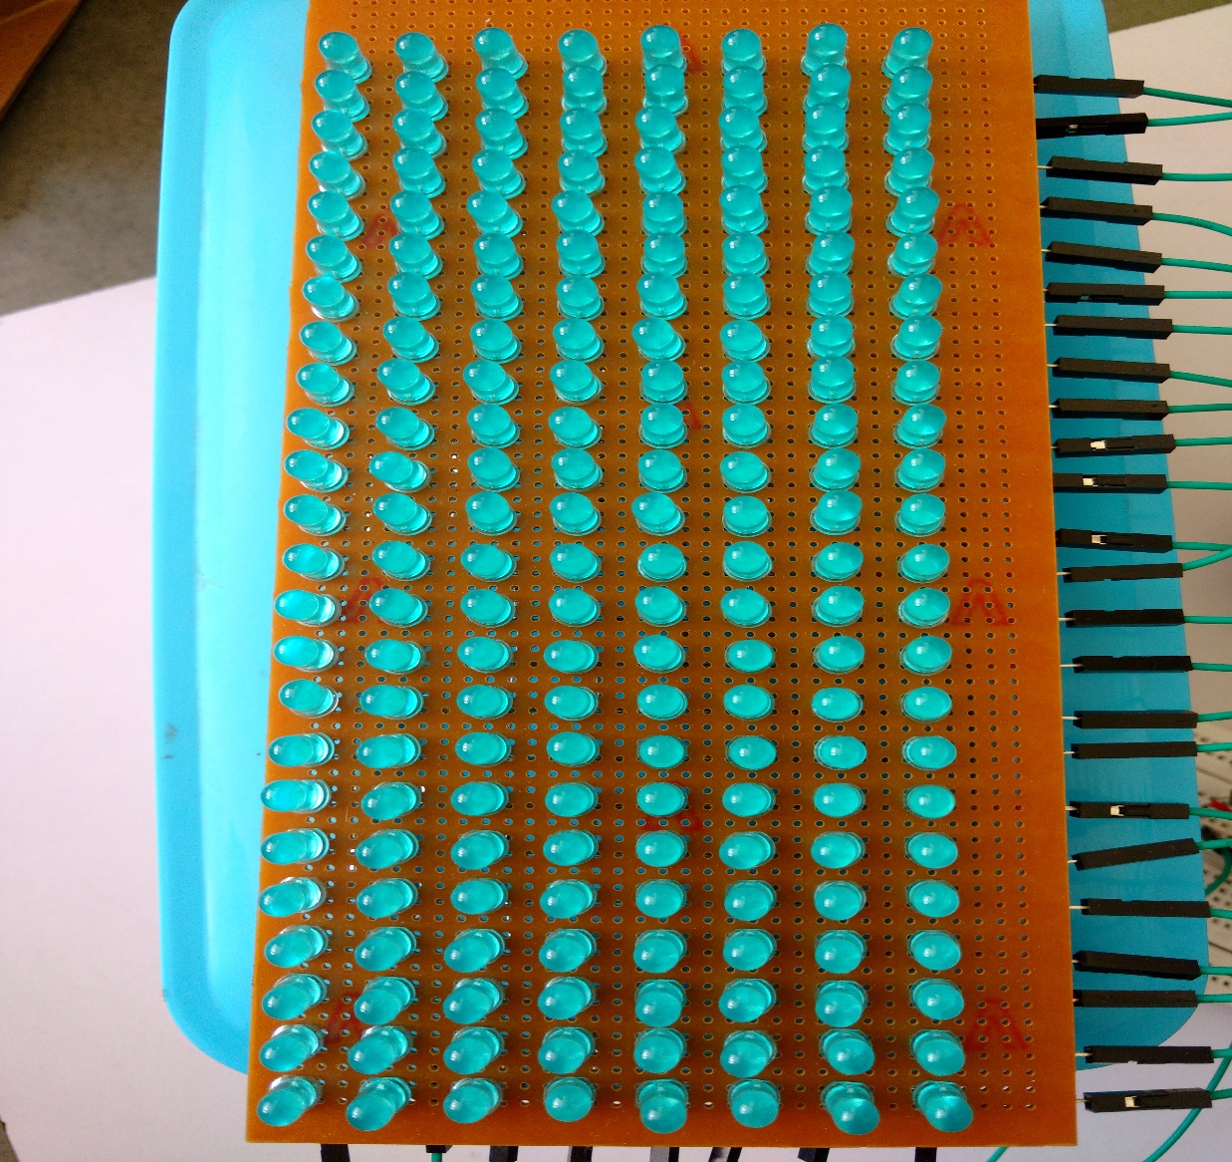
24*8 LED matrix

Slide 4
Making of LED matrix
LED’s that are in same column, their anodes are connected to each other
LED’s that are in same row, their cathodes are connected to each other by bridging over anodes.

Slide 5
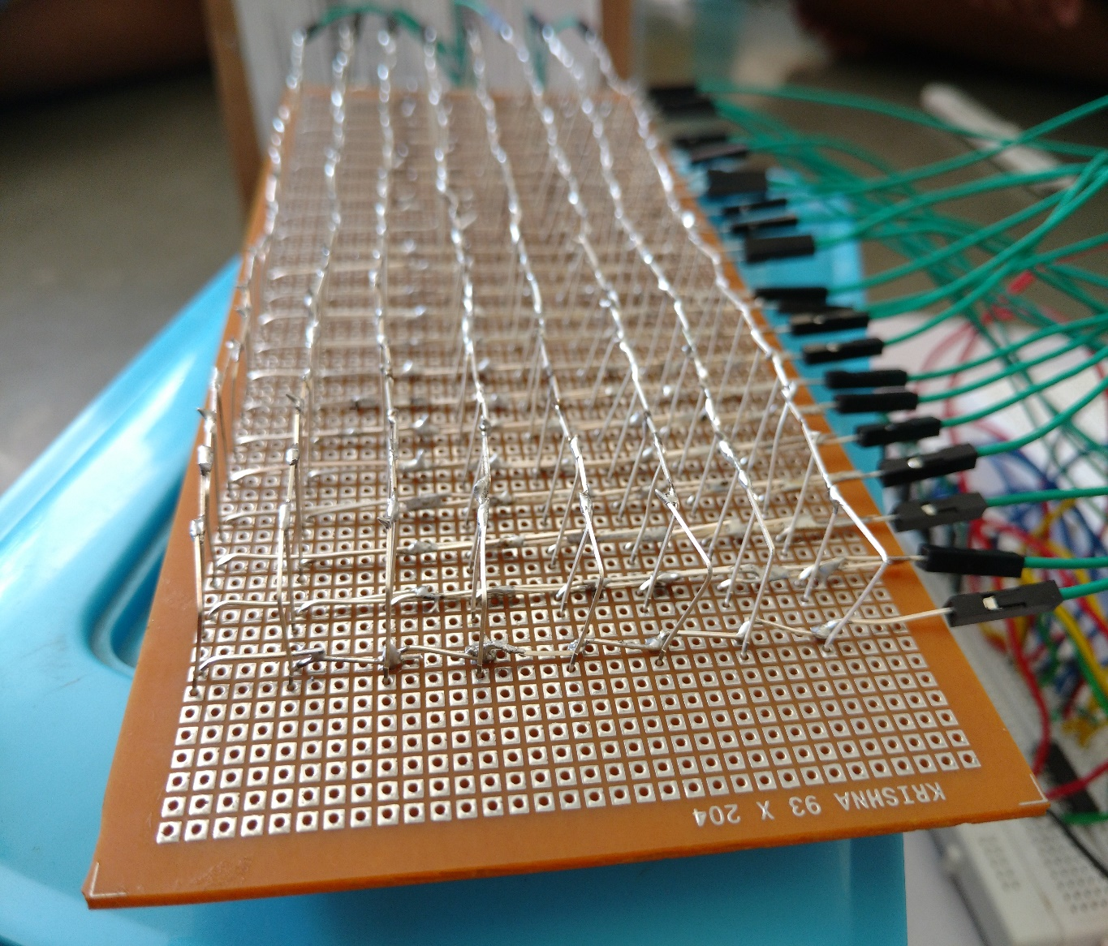

Slide 6
Components:
192 LEDs
3 x 74HC595 shift registers
24 x 100 ohm resistors
8 x 1k ohm resistors
8 x 2N3904 transistors
1 x 4017 decade counter
1 x Arduino UNO

Slide 7
Role of components
Main Role
Arduino UNO
Shift registers
Counter
LED matrix
Other
1k ohm and 100 ohm registers
NPN transistors

Slide 8
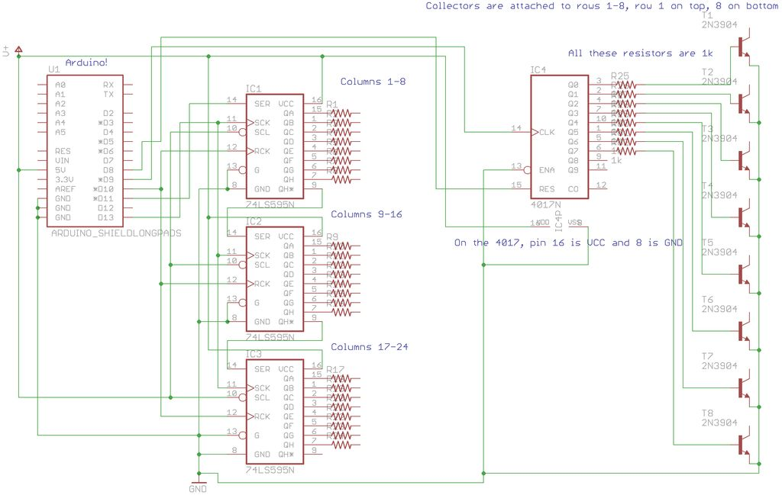
How it works

Slide 9
Displaying symbol in bits
Example : A
Bit pattern of A
Here 1 will represent high voltage or LED ON and 0 will represent Low voltage or LED OFF
00111100
01000010
01000010
01000010
01111110
01000010
01000010
01000010

Slide 10
Counter and Shift registers working
Shift registers will convert serial input to parallel output and provides it to anode of LEDs
Counter is for blinking rows one by one based on clock cycle
C
O
U
N
T
E
R
SHIFT REGISTER
0 0 1 1 1 1 1 0

Slide 11
Shift Register
At starting assume that time is t
0 0 1 1 1 1 0 0
0 1 0 0 0 0 1 0
0 1 0 0 0 0 1 0
0 1 0 0 0 0 1 0
0 1 1 1 1 1 1 0
0 1 0 0 0 0 1 0
0 1 0 0 0 0 1 0
0 1 0 0 0 0 1 0
C
O
U
N
T
E
R

Slide 12
Shift Register
At time t + 2ms
0 0 1 1 1 1 0 0
0 1 0 0 0 0 1 0
0 1 0 0 0 0 1 0
0 1 0 0 0 0 1 0
0 1 1 1 1 1 1 0
0 1 0 0 0 0 1 0
0 1 0 0 0 0 1 0
0 1 0 0 0 0 1 0
C
O
U
N
T
E
R

Slide 13
Shift Register
At time t + 4ms
0 0 1 1 1 1 0 0
0 1 0 0 0 0 1 0
0 1 0 0 0 0 1 0
0 1 0 0 0 0 1 0
0 1 1 1 1 1 1 0
0 1 0 0 0 0 1 0
0 1 0 0 0 0 1 0
0 1 0 0 0 0 1 0
C
O
U
N
T
E
R

Slide 14
Shift Register
At time t + 6ms
0 0 1 1 1 1 0 0
0 1 0 0 0 0 1 0
0 1 0 0 0 0 1 0
0 1 0 0 0 0 1 0
0 1 1 1 1 1 1 0
0 1 0 0 0 0 1 0
0 1 0 0 0 0 1 0
0 1 0 0 0 0 1 0
C
O
U
N
T
E
R

Slide 15
Shift Register
At time t + 8ms
0 0 1 1 1 1 0 0
0 1 0 0 0 0 1 0
0 1 0 0 0 0 1 0
0 1 0 0 0 0 1 0
0 1 1 1 1 1 1 0
0 1 0 0 0 0 1 0
0 1 0 0 0 0 1 0
0 1 0 0 0 0 1 0
C
O
U
N
T
E
R

Slide 16
Shift Register
At time t + 10ms
0 0 1 1 1 1 0 0
0 1 0 0 0 0 1 0
0 1 0 0 0 0 1 0
0 1 0 0 0 0 1 0
0 0 1 1 1 1 1 0
0 1 0 0 0 0 1 0
0 1 0 0 0 0 1 0
0 1 0 0 0 0 1 0
C
O
U
N
T
E
R

Slide 17
Shift Register
At time t + 12ms
0 0 1 1 1 1 0 0
0 1 0 0 0 0 1 0
0 1 0 0 0 0 1 0
0 1 0 0 0 0 1 0
0 1 1 1 1 1 1 0
0 1 0 0 0 0 1 0
0 1 0 0 0 0 1 0
0 1 0 0 0 0 1 0
C
O
U
N
T
E
R

Slide 18
Shift Register
At time t + 14ms
0 0 1 1 1 1 0 0
0 1 0 0 0 0 1 0
0 1 0 0 0 0 1 0
0 1 0 0 0 0 1 0
0 0 1 1 1 1 0 0
0 1 0 0 0 0 1 0
0 1 0 0 0 0 1 0
0 1 0 0 0 0 1 0
C
O
U
N
T
E
R

Slide 19
Shift Register
So in 14 ms our symbol is displayed row by row to
Led screen
But its too fast to our eyes to catch it will be look like this to us
0 0 1 1 1 1 0 0
0 1 0 0 0 0 1 0
0 1 0 0 0 0 1 0
0 1 0 0 0 0 1 0
0 1 1 1 1 1 1 0
0 1 0 0 0 0 1 0
0 1 0 0 0 0 1 0
0 1 0 0 0 0 1 0
C
O
U
N
T
E
R

Slide 20
How to scroll symbols?
Shift Register
0 1 1 1 1 1 0 0
Shift register is also provided a clock cycle so after one cycle all outputs of shift register are shifted to next column

Slide 21
How to scroll symbols?
Shift Register
0 0 1 1 1 1 1 0 1
Vanished bit
New bit
Clock cycle of shifting is slower than clock cycle of counter so we can’t see the difference between shifting of rows and shifting of columns

Slide 22
The role of NPN transistor
The LED need high voltage at anode and low voltage at cathode in order to blink properly
Transistor are connected to cathodes and act as low side Switch to control low voltage at cathodes

Slide 23
Applications:
Display signs
As Decoratives
Interactive LED matrix display
LED TV

Slide 24
Thank You

